Slide 1
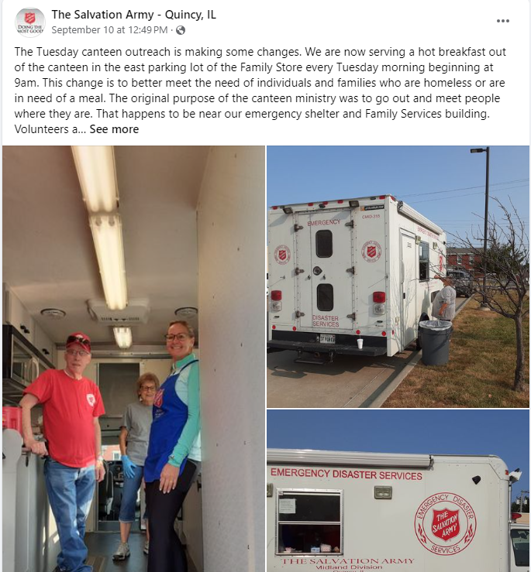
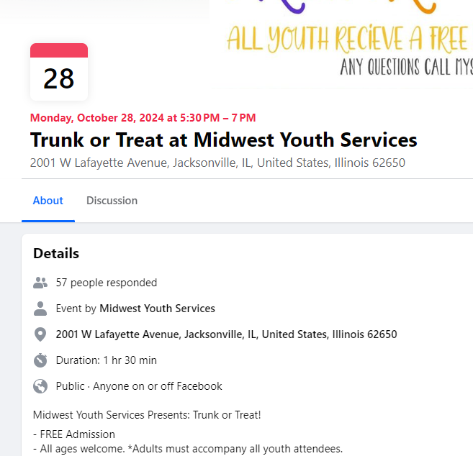

Slide 2
CoC Builds
CoC Competition FY24/25
IHDA PSH & Non-Congregate Shelter

Slide 3
Two Concurrent NOFOs?!
 | CoC Builds | CoC Annual
Due Date | November 21, 2024 | October 30, 2024
Goal | Building new PSH | Housing via private LL+ supportive services
Eligible Activities | Acquisition, Rehabilitation, Construction; limited Operating and Admin | Leasing or Rental Assistance, Operating, Supportive Services, HMIS, Admin. Method of delivery is dependent on project type: Joint TH-RRH, RRH, PSH
Process | Submit a narrative via email | Submit applications via esnaps portal 1 NOFO, 2 years of funding
More Info | August 14 2:00 – 3:30 EST (HUD) | August 28 12:00 – 1:30 EST (NAEH)

Slide 4
Next Steps: Intent To Apply Letter
CoC Builds
Send Intent to Apply letter to CoC Board
Summary of proposed project
IHDA PSH and/or Non-Congregate Shelter
Communicate your intent to other agencies so we’re collaborating, not competing
CoC Annual Application
Send Intent to Apply letter to CoC Board – new projects
Joint TH-RRH
RRH
PSH
Partners
Get ready to speak on your area of expertise in the CoC Application

Slide 5
HELP! Victim Service Providers
1C-5b. Implemented Safety Planning, Confidentiality Protocols in Your CoC’s Coordinated Entry to Address the Needs of Survivors of Domestic Violence, Dating Violence, Sexual Assault, and Stalking.
1C-5c. Coordinated Annual Training on Best Practices to Address the Needs of Survivors of Domestic Violence, Dating Violence, Sexual Assault, and Stalking.
1C-5d. Implemented VAWA-Required Written Emergency Transfer Plan Policies and Procedures for Domestic Violence, Dating Violence, Sexual Assault, and Stalking.
1C-5e. Facilitating Safe Access to Housing and Services for Survivors of Domestic Violence, Dating Violence, Sexual Assault, and Stalking.

Slide 6
HELP! Youth Service Providers
1C-4. CoC Collaboration Related to Children and Youth–SEAs, LEAs, School Districts.
1C-4a. Formal Partnerships with Youth Education Providers, SEAs, LEAs, School Districts.
2B-3. PIT Count–Effectively Counting Youth in Your CoC’s Most Recent Unsheltered PIT Count.
1C-4c. Written/Formal Agreements or Partnerships with Early Childhood Services Providers.

Slide 7
HELP! Employment & Education Providers
1C-4b. Informing Individuals and Families Who Have Recently Begun Experiencing Homelessness about Eligibility for Educational Services.
1D-10b. Professional Development and Employment Opportunities for Individuals with Lived Experience of Homelessness.

Slide 8
October CoC Meeting Agenda
CoC Application finishing touches
Maseta Dorley, technical Assistance Provider, TAC, Inc
CoC 101

